Slide 1
Business Communication
Lecture by Faryal sheikh

Slide 2
Business communication, writing skills
Written Communication involves expressing yourself clearly, using language with precision; constructing a logical argument; note taking, editing and summarizing; and writing reports. Structure and layout can be relatively quickly learnt but learning how to write good quality content takes much longer

Slide 3
Elements
Structure – the way the content is laid out
Style – the way it is written
Content – what you are writing about

Slide 4
Importance of written communication for business
Communication is a powerful asset to any business, if used well it can improve your company's performance and reputation, as well as your staff engagement and morale. In this article, we explore three reasons why professional business writing is good for your organization. We also guide you on metrics to use to convince your stakeholders that business writing training is a valuable investment.

Slide 5
Reasons
1. Increased performance and productivity
Clear, coherent and concise messaging reduces the amount of time spent reading messages and asking the writer to clarify. It also reduces miscommunication and results in quicker, more accurate action. These, in turn, increase productivity, resulting in cost savings to the team and organisation.

Slide 6
2. Improved brand image and reputation
Strong business writing reinforces your organisation’s brand and sets the tone of your interactions with customers and clients. When it is done consistently well, it enhances your image, reduces negative interactions with external stakeholders and increases customer loyalty.

Slide 7
3.Increased staff engagement
Good business writing ensures that the vision and strategy of the organisation and the leadership team are communicated to staff, which inspires and engages them. Good writing within teams can foster collaboration, increase each individual’s sense of belonging and make work more meaningful.

Slide 8
8 best practices to improve written communication
Think about the purpose of your message.
Put yourself in your reader's shoes.
Keep it simple.
Keep a place to jot down thoughts and ideas.
Write and read often.
Edit fiercely and read the message out loud.
Ask for help.
Constructive criticism as growth.

Slide 9
Four different types of writing techniques in business:
Descriptive writing style. Descriptive writing immerses the reader into a story by creating a vivid picture of characters, settings and events in their mind. ...
Narrative writing style. ...
Persuasive writing style. ...
Expository writing style.

Slide 10
Types of Business Writing
The broad field of business writing can be distilled into four categories based on their objective, such as:
1. Instructional
The instructional business writing type is directional and aims to guide the reader through the steps of completing a task. A user manual falls aptly under the instructional category, as well as a memo issued to all employees outlining the method of completing a certain task in the future.

Slide 11
Informational
Informational business writing pertains to recording business information accurately and consistently. It comprises documents essential to the core functions of the business for tracking growth, outlining plans, and complying with legal obligations. For example, the financial statements of a company, minutes of the meeting, and perhaps the most important, report writing.

Slide 12
3. Persuasive
The goal of persuasive writing is to impress the reader and influence their decision. It conveys relevant information to convince them that a specific product, service, company, or relationship offers the best value. Such a type of writing is generally associated with marketing and sales. It includes proposals, bulk sales emails, and press releases.

Slide 13
4. Transactional
Day-to-day communication at the workplace falls under the transactional business writing category. The bulk of such communication is by email, but also includes official letters, forms, and invoices.

Slide 14
Summary
Business writing is a purposeful piece of writing that conveys relevant information to the reader in a clear, concise, and effective manner.
It can be categorized into four types: instructional, informational, persuasive, and transactional.
Clarity of thought, conciseness, correct grammar and sentence structure, and simple language characterize effective business writing.

Slide 15
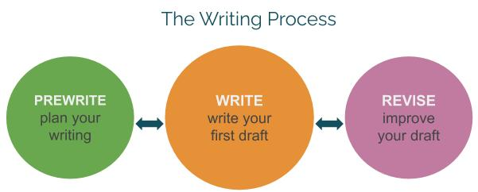
Three steps of writing process

Slide 16
Prewriting
In the prewriting stage, you might read an assignment prompt, research, make an outline, sketch some ideas, brainstorm, doodle, jot down notes or even just think about your writing topic.

Slide 17
Writing
In the writing or drafting stage, you write down words. Your writing task will determine how you write. Some people write long or important documents by composing them in a notebook and then typing out the final product. Some write in one long paragraph and then break it up in the revision stage.

Slide 18
Revision
After you’ve finished writing, it’s time to rethink your piece. Many students think that revising is just making grammatical changes, but it’s a lot more than that. Expert writers often spend most of their composition time on revision. They may rethink their strategy, try a new outline, show their work to a colleague to get feedback, read their work out loud to see where it sounds choppy or simply put the work away for a few hours so that they can come back to it with a fresh perspective.

